Slide 1
Parallel Computing

Slide 2
Team Member
Nora Elsayed
Omnia Nasef
Rawan Rajab
Lobna Nady
Reem Ibrahim
Asmaa Gamal

Slide 3
01
Gaussian Blur

Slide 4
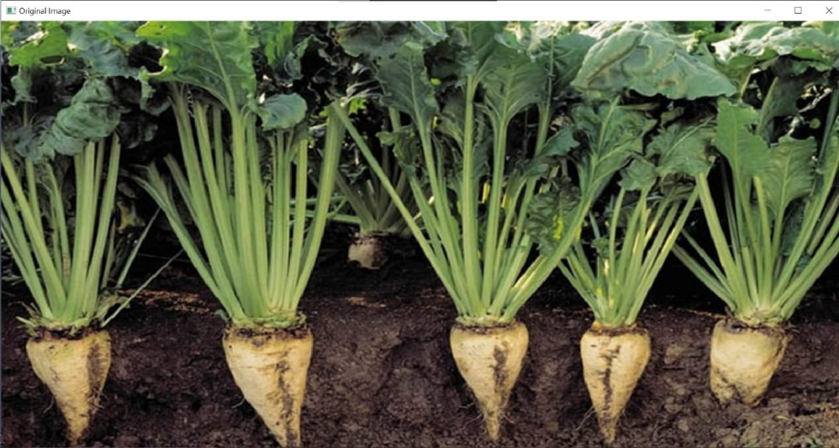
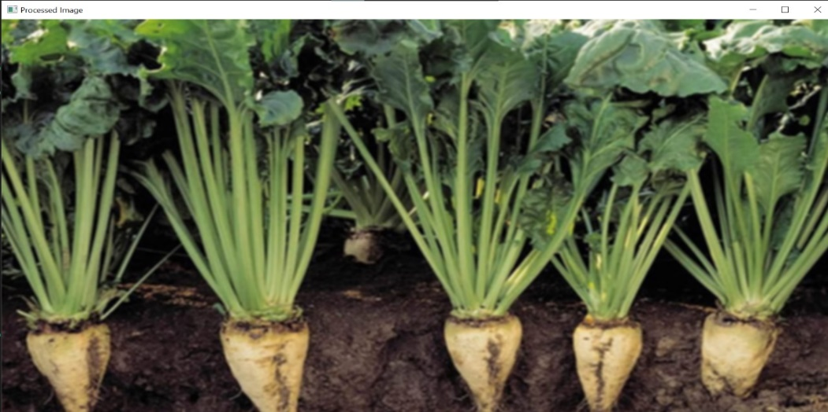
Reduce fine details in images and the overall appearance looks beautiful.
To implement this in Parallel Computing , Divide image rows ber number of process we need This By Scatter
And Then implement function of Gaussian Blur in each pieces of image , and Finally combine all pieces together by Gather

Slide 5
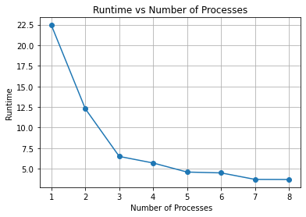
The more the number of process increases, the less time it takes to execute the function.

Slide 6
02
Edge Detection

Slide 7
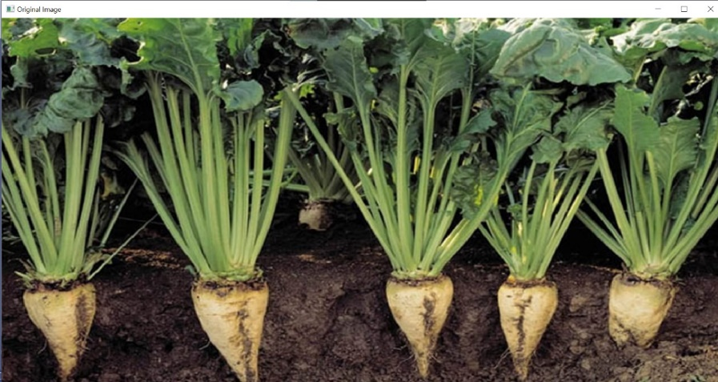
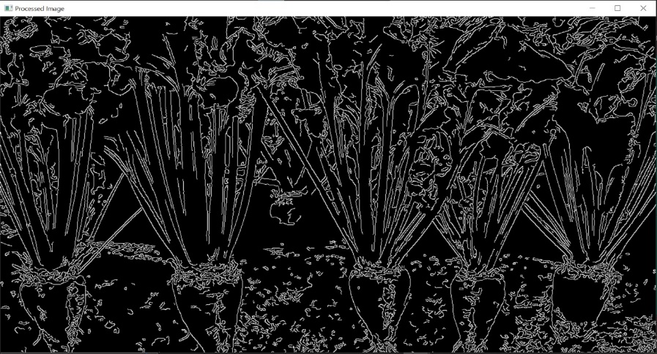
Edge detection is used to identify areas in an image where extreme changes in light or color occur, which can be used to identify objects or structures within the image.
To implement this in Parallel Computing , Divide image rows ber number of process we need This By Scatter
And Then implement function of Edge Detection in each pieces of image , and Finally combine all pieces together by Gather.

Slide 8
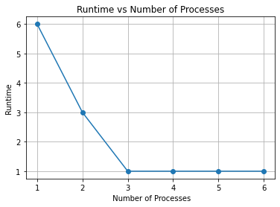
The more the number of process increases, the less time it takes to execute the function.

Slide 9
03
Image scaling

Slide 10

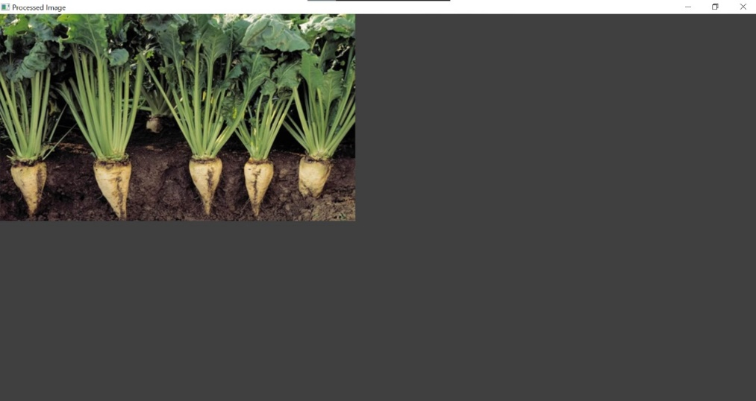
The image resizing process adjusts the size of the image to suit specific needs, allowing it to be enlarged or reduced without distorting the quality
To implement this in Parallel Computing , Divide image rows ber number of process we need This By Scatter
And Then implement function of Image Scaling in each pieces of image , and Finally combine all pieces together by Gather.

Slide 11
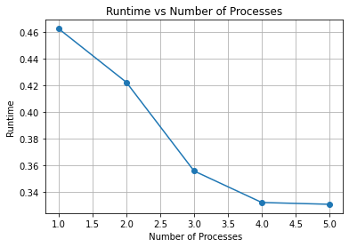
The more the number of process increases, the less time it takes to execute the function.

Slide 12
04
Median

Slide 13

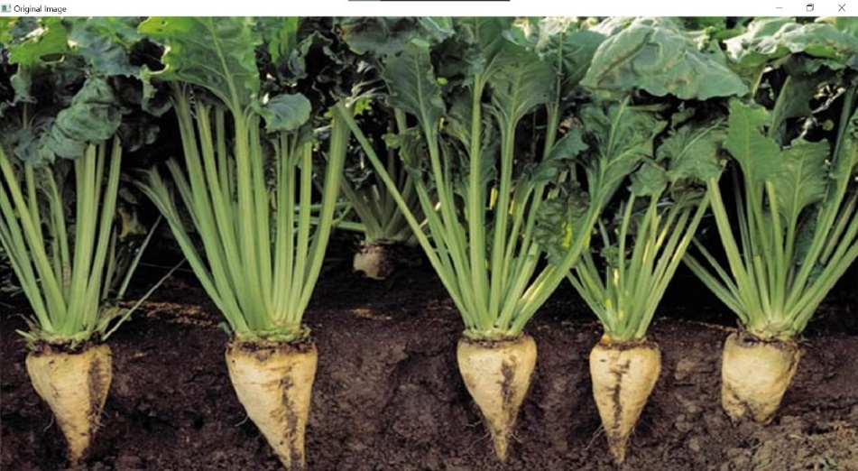
It reduces noise in the image by replacing the values ​​of each pixel with the average value of a group of values ​​surrounding it, which contributes to improving and purifying the image quality.
To implement this in Parallel Computing , Divide image rows ber number of process we need This By Scatter
And Then implement function of Median in each pieces of image , and Finally combine all pieces together by Gather.

Slide 14
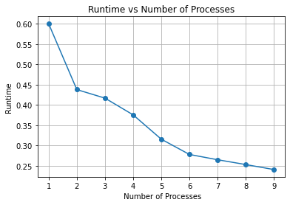
The more the number of process increases, the less time it takes to execute the function.

Slide 15
Histogram Equalization
05

Slide 16

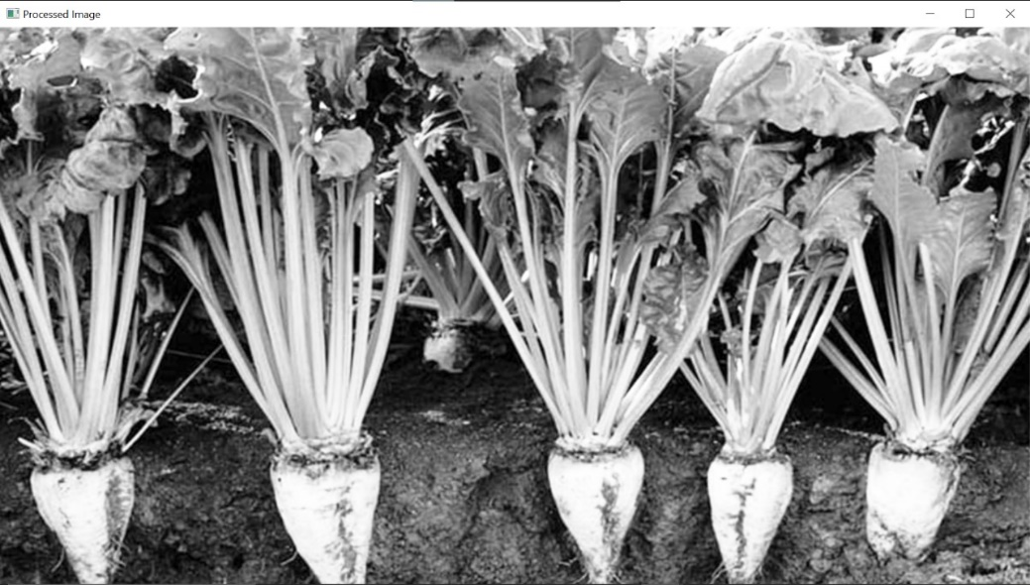
The process of equalizing the histogram increases contrast and improves clarity in the image by adjusting the light distribution, resulting in improved image quality and uniformity.
To implement this in Parallel Computing , Divide image rows ber number of process we need This By Scatter
And Then implement function of Histogram Equalization in each pieces of image , and Finally combine all pieces together by Gather.

Slide 17
The more the number of process increases, the less time it takes to execute the function.

Slide 18
Color Space Conversion
06

Slide 19

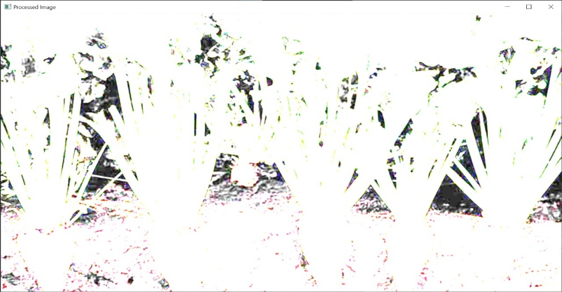
The process of color space conversion converts the representation of colors in an image from one color system to another, which helps in improving visualization and processing of images and adapting them to the requirements of different applications.
To implement this in Parallel Computing , Divide image rows ber number of process we need This By Scatter
And Then implement function of Color Space Conversion in each pieces of image , and Finally combine all pieces together by Gather.

Slide 20
The more the number of process increases, the less time it takes to execute the function.

Slide 21
Global Thresholding
07

Slide 22
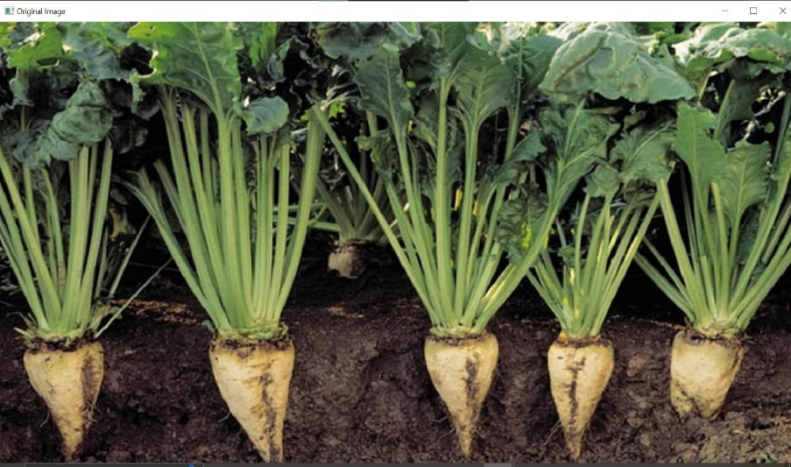
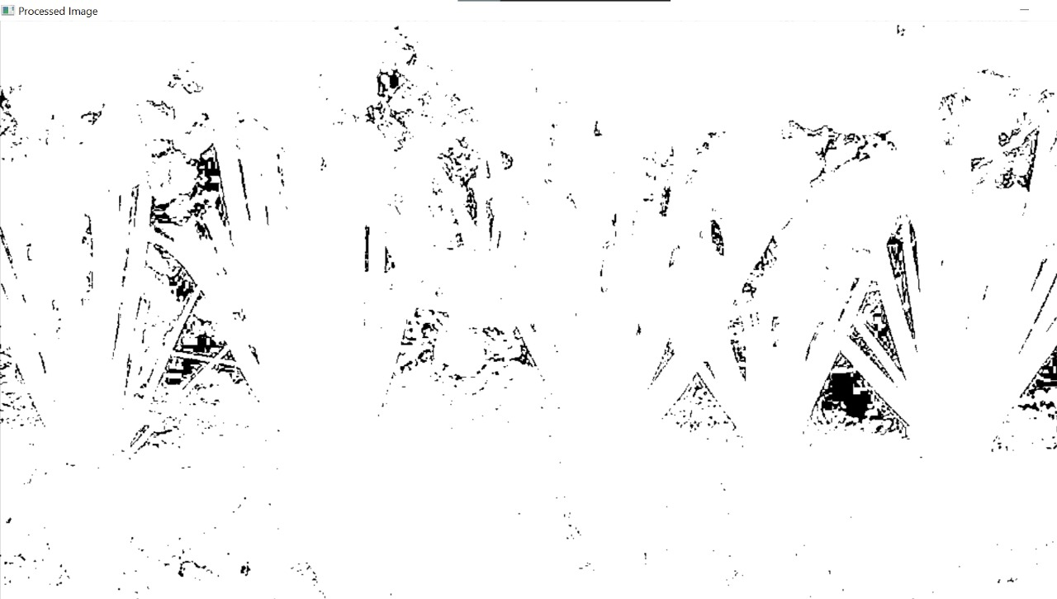
It is used to convert a digital image into a binary image by applying a single threshold over the entire image, enabling the desired parts to be effectively distinguished.
To implement this in Parallel Computing , Divide image rows ber number of process we need This By Scatter
And Then implement function of Global Thresholding in each pieces of image , and Finally combine all pieces together by Gather.

Slide 23
The more the number of process increases, the less time it takes to execute the function.

Slide 24
Local Thresholding
08

Slide 25

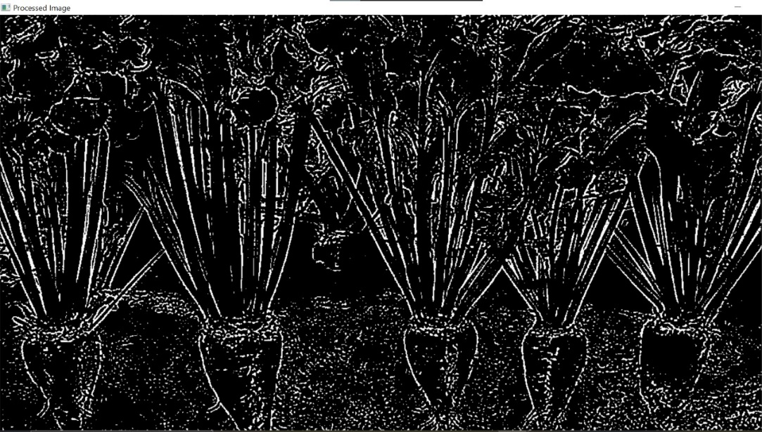
It is used to convert a digital image into a binary image by applying a single threshold over the entire image, enabling the desired parts to be effectively distinguished.
To implement this in Parallel Computing , Divide image rows ber number of process we need This By Scatter
And Then implement function of Local Thresholding in each pieces of image , and Finally combine all pieces together by Gather.

Slide 26
The more the number of process increases, the less time it takes to execute the function.

Slide 27
Image Rotation
09

Slide 28

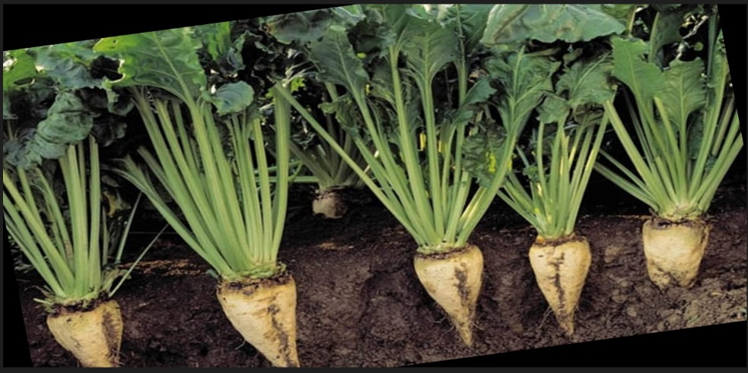
The process of rotating the image changes the orientation of the image around a specific axis, which allows changing the angle and improving the orientation of the image without affecting its content.
To implement this in Parallel Computing , Divide image rows ber number of process we need This By Scatter
And Then implement function of Rotation in each pieces of image , and Finally combine all pieces together by Gather.

Slide 29
The more the number of process increases, the less time it takes to execute the function.

Slide 30
convert to grayscale
10

Slide 31

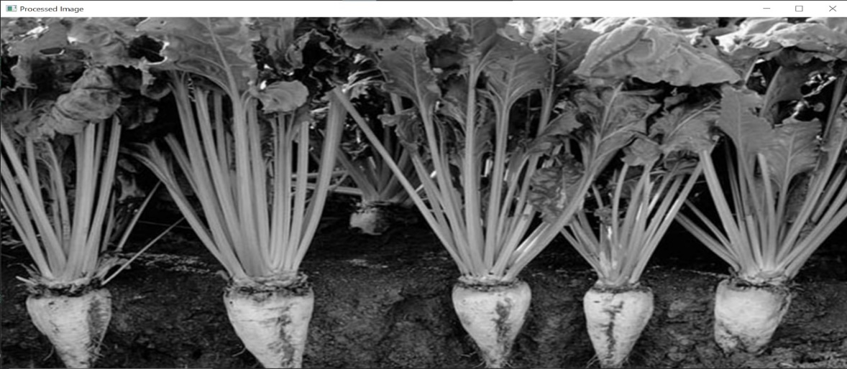
The process of converting an image to grayscale alters its color composition, blending the RGB channels into a single luminance channel, which allows for the preservation of its essence while simplifying its visual representation. This transformation improves the clarity and focus of the image without altering its underlying content
In order to implement grayscale conversion in Parallel Computing, we divide the rows of the image by the number of processes required. This is done using scatter operations. Subsequently, we apply the grayscale conversion function to each piece of the image independently.
Finally, we combine all the pieces together using gather operations to reconstruct the complete grayscale image. This parallel approach significantly accelerates the grayscale conversion process while efficiently utilizing computational resources.

Slide 32
As the number of processes increases, the execution time of the grayscale conversion function decreases. This is because the workload is distributed across multiple processors, allowing for concurrent processing of image segments. With more processes engaged, the computational tasks are completed in parallel, resulting in faster overall execution of the grayscale conversion.

Slide 33
Color space operation
11

Slide 34

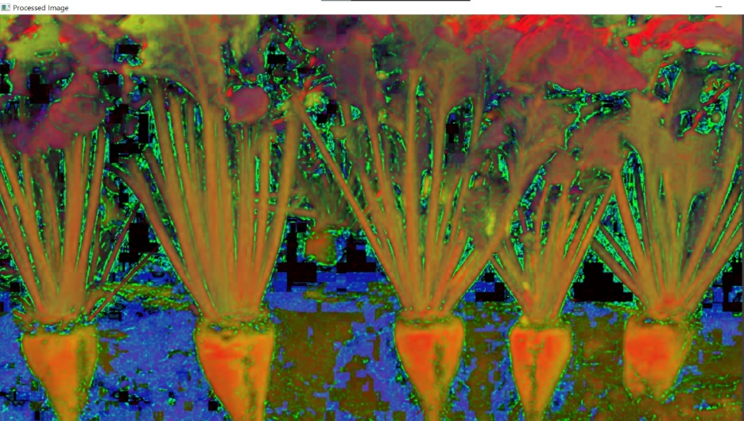
The process of applying a color space operation modifies the color representation of the image without altering its content. By transforming the image's color model, such as converting from RGB to CMYK or HSV, adjustments to hue, saturation, brightness, or other color attributes can be made. This alteration enables fine-tuning of the image's visual appearance while preserving its underlying content.
To implement color space operation in Parallel Computing, we divide the image rows by the number of processes required using scatter operations. Each process then applies the color space transformation function to its assigned image segment independently.
Finally, all processed segments are combined together using gather operations to reconstruct the complete image with the color space transformation applied.

Slide 35
As the number of processes increases, the execution time of the color space operation decreases. This is because the workload is distributed across multiple processors, enabling concurrent processing of image segments. With more processes engaged, the computational tasks are completed in parallel, resulting in faster overall execution of the color space transformation.

Slide 36
Thanks

